Slide 1
Quiz Conducting App
Under the counselling of Sanket Sir.
Prepared by
Rabadiya Dhyey (20IT118)
Shah Shail (20IT135)
Savaliya Jenil (20IT125)
We are students of 2nd year (3rd semester) IT department CSPIT.

Slide 2
Content
Definition
Time schedule of what we did till now
Functional and Non-functional requirements
Software, hardware and language requirement
Flowchart preparation
Detail note on our definition
Reference for our project
Conclusion of the project

Slide 3

Definition
Quiz conducting application for all languages.

Slide 4
Time Schedule Of What We Did Till Now
Date | Task
31st July | Found the definition for SGP project.
1st August – 28th August | We understood the definition and referred to some YouTube videos.
29th August – 11th September | We learned Java Swing, AWT and how to use Apache NetBeans.
18th September and so on. | We are going to make quiz application and the code needed for it.

Slide 5
Functional and Non-functional requirements
Functional Requirements:
Questions will get shuffled once you open the quiz page again.
Students can see their score immediately after the completion of the quiz with the correct answers and explanation.
Students can login from any credentials.
Non-functionalities Requirements:
Reusability of the application
Flexibility of the application
It will work in all types of PCs/laptops.

Slide 6
Software, Hardware and Language Requirement
Software: Apache NetBeans.
Hardware: Normal Pcs are allowed, i.e. i3/i5/i7 processor
4 GB RAM barrier
Language: Java Swing and AWT for Frontend
MySQL database for Backend

Slide 7
Flow Of The Project
Planning for the Definition
Learned basics of Java Swing
Design for the quiz app
Working on the code

Slide 8
Description Of Java Swing And Use Of It In Our Project
Java Swing components are platform independent.
They are lightweight.
Swing provides more powerful components such as tables, lists, scroll panes, color chooser etc.
It is used in Front End in our project.

Slide 9

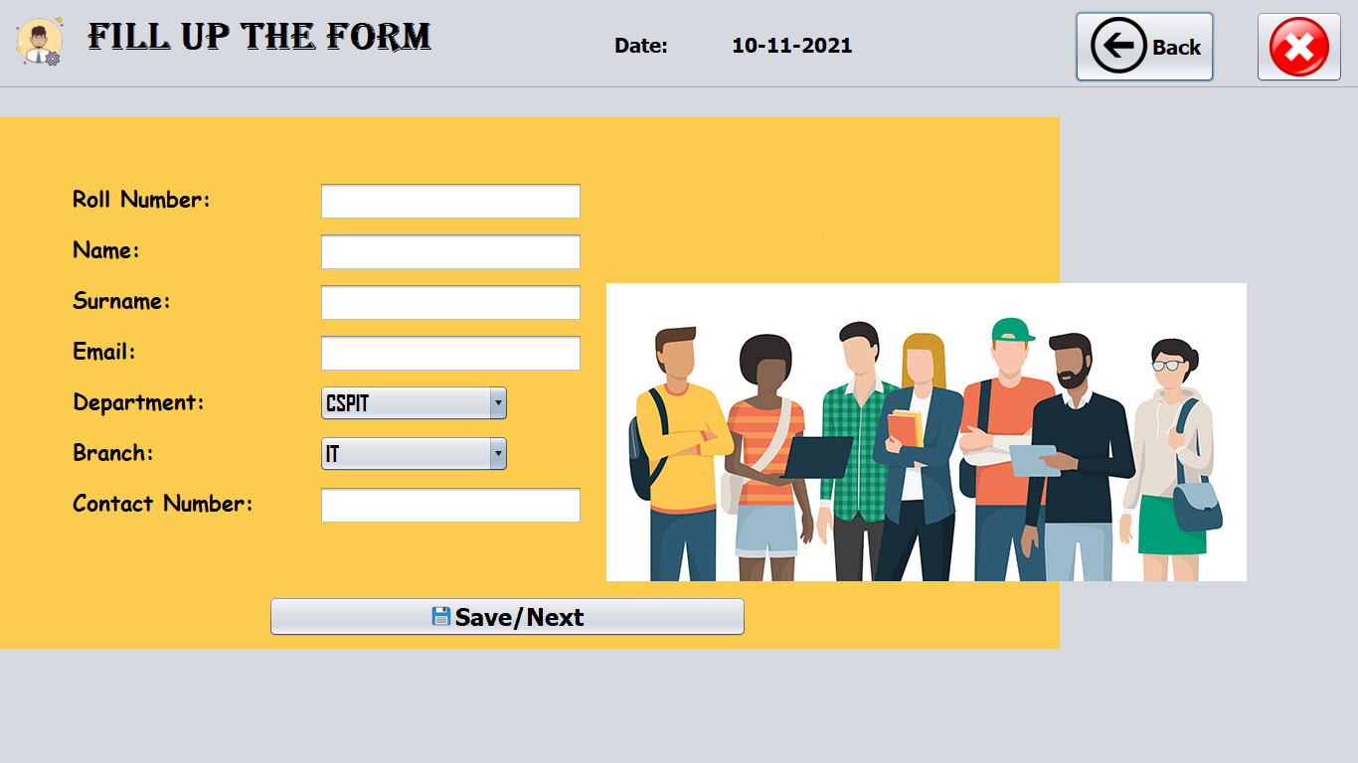
Screenshot of some pages

Slide 10
What Is Quiz Conducting Application
As the name suggests, the quiz application is an application that allows one in organizing the online quiz.
Quiz is the method of answering to the questions that has been asked based on the general knowledge, related to the recent covered topics and so on.
The user interface must be simple and easy to understand even by the common man.
The main goal of the application is to enable users to practice for subjective tests conducted for national level exams.

Slide 11
References
https://youtu.be/riDzcEQbX6k
https://www.youtube.com/watch?v=Yah0bKzHIng
YouTube Channels:
Code With Harry
TCODE Studio

Slide 12
Conclusion
Our main aim for this application is to provide better application with flexibility and reliability.
Quiz conducting application is very easy and simple to use and access. One can give the exams as per his/her choice and by adding that categories particular questions.
We have future plan to add the categories section so that the user does not have to enter the questions manually and it will be easy for the user to give the exam of that particular category.

